Slide 1
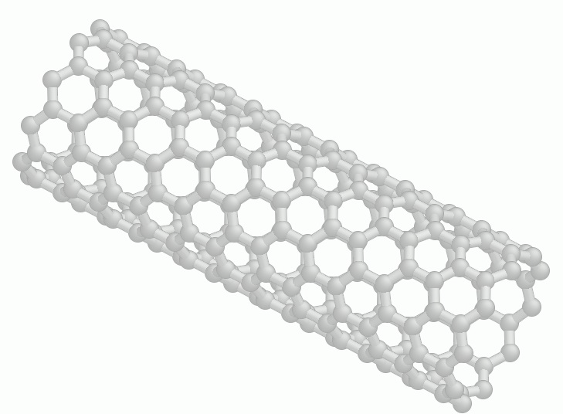
Carbon Nanotubes
By Ken Chang and
Eric Bartell

Slide 2
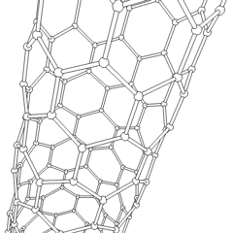
What are carbon nanotubes???
Carbon nanotubes are a type of carbon crystal in a cylindrical shape
Has a length to diameter ratio of up to 132 million to 1
Their structures are hexagonal, effectively tubes of graphite sheets

Slide 3
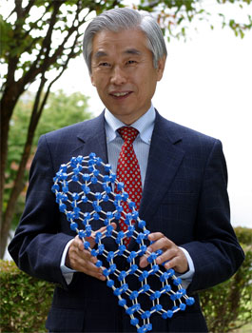
The History of Nanotubes
The theory behind nanotubes was first proposed in Russia by L. V. Radushkevich and V. M. Lukyanovich in 1952, but went unnoticed.
Single walled nanotubes were first discovered in 1976 by Japanese scientists.
Multi walled nanotubes were first discovered first in 1991 by NEC (a japanese multinational company), beating its competition, IBM.

Slide 4
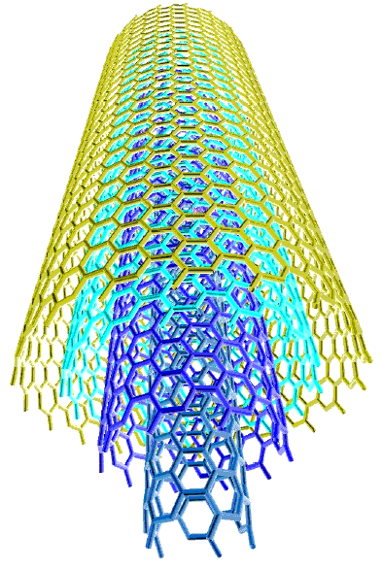
Different types of Nanotubes
There are two types of carbon nanotubes: Multi walled nanotubes (MWNT) and Single walled (SWNT). Multi walled have multiple layers of carbon nanotubes around a single one, whereas single walled have only one layer.

Slide 5

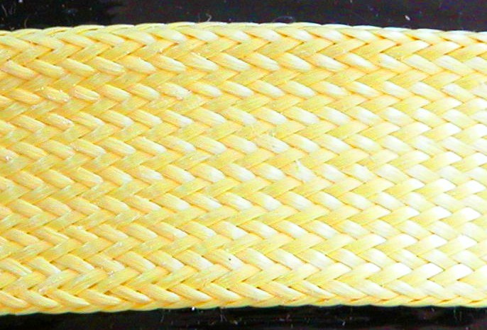
Strength of the different types
The strength of MWNTs are greater than SWNTs, but varies. The range of SWNT tensile strengths are 13–53 GPa (Gigapascals) while MWNTs are around 11-150 GPa depending on thickness and manufacturing quality. In comparison, the tensile strength of Stainless steel is 0.36-1.55 GPa and Kevlar is 3.6-3.8 GPa.

Slide 6

Properties of carbon nanotubes
Generally semiconductors, although MWNT with interconnected inner shells show superconductivity with a relatively high transition temperature - Tc = 12 K.
  The transition temperature is when the material is no longer a superconductor.

Slide 7
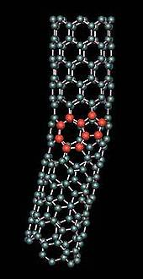
Defects in Carbon nanotubes
Atomic vacancies (where entire atoms are missing)
Stone Wales defect – a pentagon and heptagon pair is formed (instead of 2 hexagons)
These defects can reduce strength by up to 85%

Slide 8
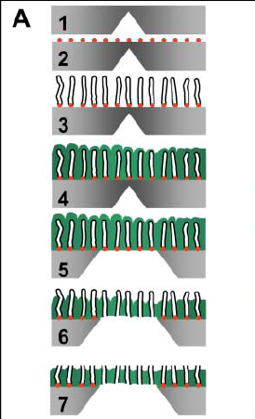
How Nanotubes are Made
Silicon carbide (SiC) is the material used to make the nanotubes.
A catalyst are placed on the SiC.
The nanotubes grow off the SiC.
Si₃N₄ is deposited through low pressure chemical vapor.

Slide 9
Continued
XeF₂ is used to dissolve part of the silicon to open one side of the nanotubes.
Silicon Nitride and Argon are used to remove the catalyst particles.
The nanotube is uncapped with the addition of reactive ions.

Slide 10
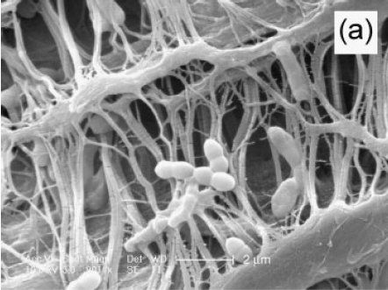
Bacterial Filtration
Two long, multiwalled carbon nanotubes are put parallel, and deionized water and ethanol is run through perpendicular, causing nanotubes to form in between the two main nanotubes. This can then be used to filter out bacterium, like E. Coli.

Slide 11
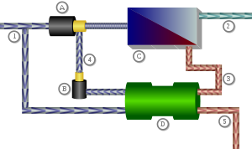
Filtration and Desalination
Carbon nanotubes can, and will, block nanoparticles that are bigger than the diameter of the carbon nanotube.
The pores are big enough to let water molecules through.
It could be used to replace the expensive membranes that are currently being used in desalination through reverse osmosis.
A Carbon nanotube filter would replace the current expensive filters at point A.

Slide 12
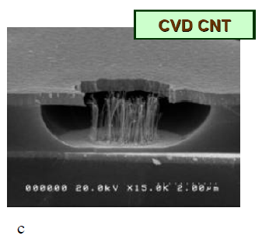
Computer chips
Most flash memory cells has 3 gates, about a micrometer in between each.
Using carbon nanotubes, the distance between these gates can be shrunk by a factor of 1000, to the size of 1 nanometer.
This means that much more memory can be held in the same size chip.

Slide 13
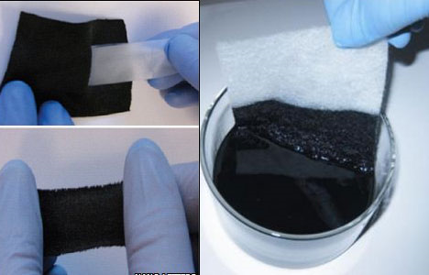
Current Research
Currently universities like Yale are the forefront of carbon nanotube research.
Large scale manufacturers like Dupont and Motorola manufacture carbon nanotubes much more than researchers.

Slide 14
Barriers to Research
Funding
Making the carbon nanotubes all the same size, uniform, and parallel.
SiC is very expensive, and is a key component in the creation of carbon nanotubes
Defects occur often, making the nanotubes much weaker

Slide 15
Sources
Holt, Jason K. "Fast Mass Transport Through Sub-2-Nanometer Carbon Nanotubes." Science 312 (2006): 1034-037. AAAS. Web. 25 May 2010. <www.sciencemag.org>.
Brady-Estevez, Anna S., Seoktae Kang, and Menachem Elimelech. "A Single-walled-carbon-nanotube Filter for Removal of Viral and Bacterial Pathogens." Small 4.4 (2008): 481-84. Wiley InterScience. Web. 25 May 2010. <www.small-journal.com>.
Kang, Seoktae, Debora F. Rodrigues, and Menachem Elimelech. "Anitbacterial Effects of Carbon Nanotubes: Size Does Matter!" Langmuir 24.13 (2008): 6409-413. Yale University. Web. 25 May 2010. <Pubs.acs.org>.
Hart, A. John. "Electronic, Optical, and Optoelectronic Applications of Carbon Nanotubes." International Assesment of Research and Development of Carbon Nanotube Manufacturing and Applications (2007): 45-61. World Technology Evaluation Center, Inc. Web. 28 May 2010. <www.nonomed.yonsei.ac.kr>.
Insepov, Z. "New Nanopumping Effects with Carbon Nanotubes." (2009). Web. 28 May 2010. <www.mcs.anl.gov>.

